Slide 1
Modern RNN

Slide 2
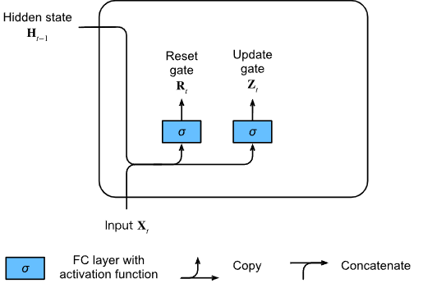

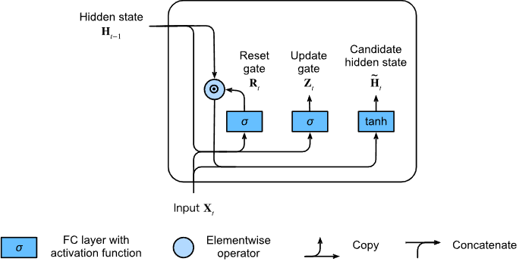

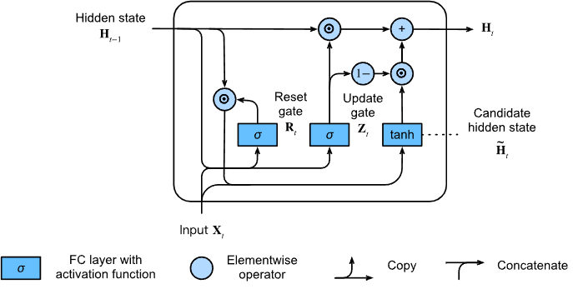

GRU
Notes:
https://d2l.ai/chapter_recurrent-modern/gru.html

Slide 3
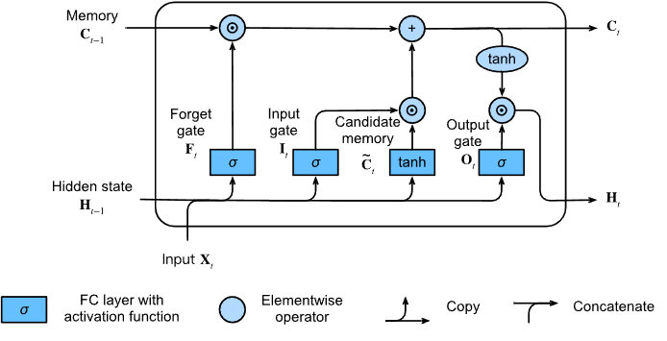




LSTM

Slide 4
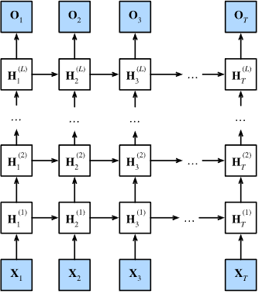


Deep RNN

Slide 5

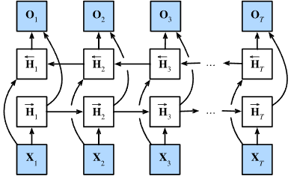

Bidirectional RNN
Notes:
https://d2l.ai/chapter_recurrent-modern/bi-rnn.html

Slide 6
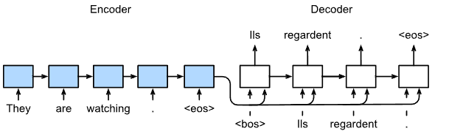
Sequence to sequence model
Code example

Slide 7
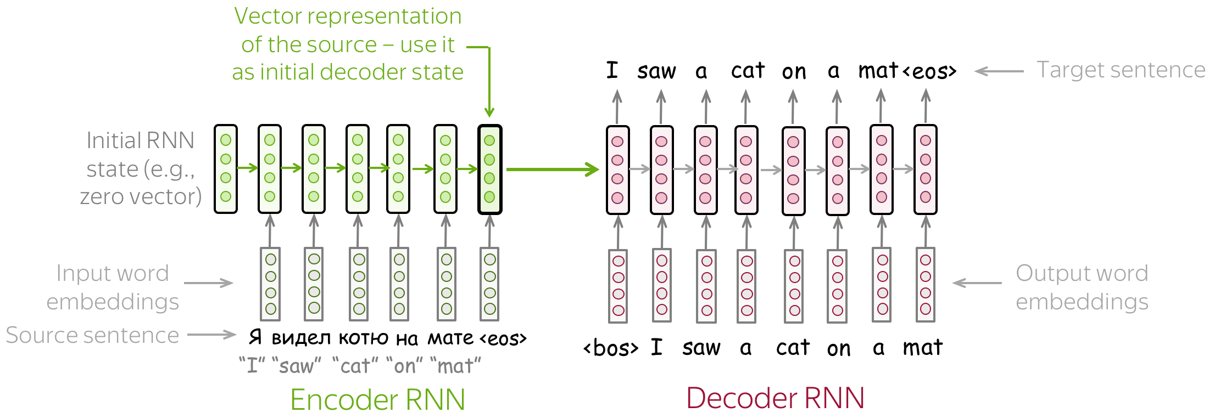
Sequence to sequence model

Slide 8
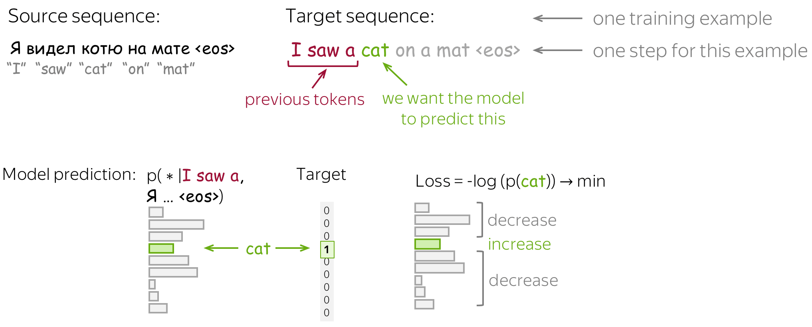
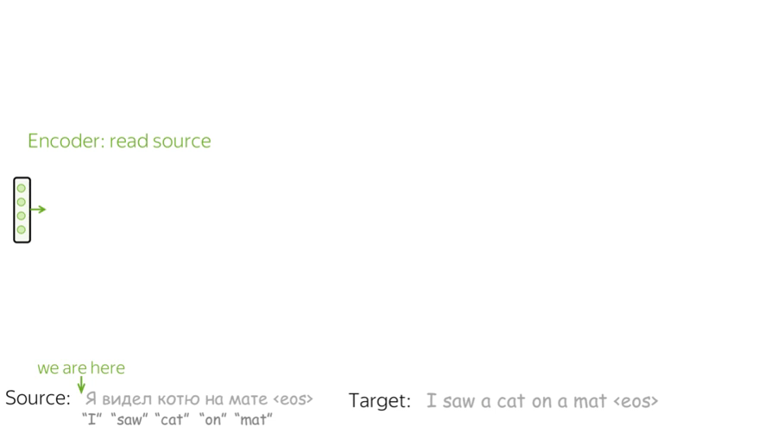
Sequence to sequence model (training)

Slide 9
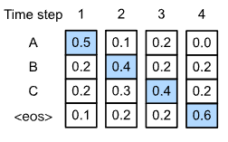
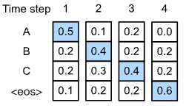
Greedy search

Slide 10
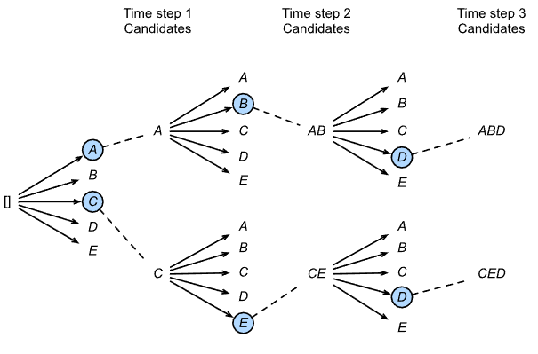
Beam search

Slide 11
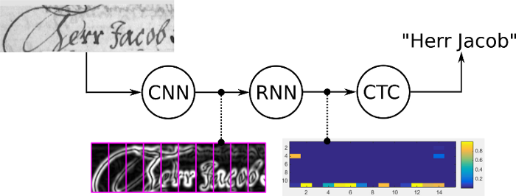
OCR

Slide 12
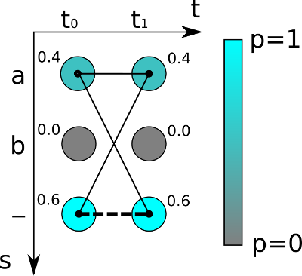
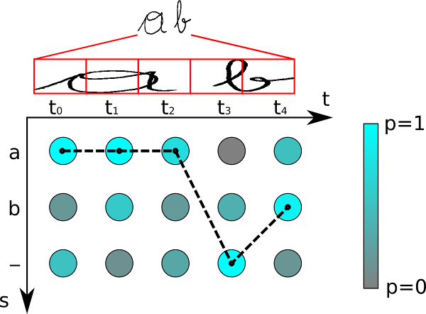
CTC loss
Notes:
https://towardsdatascience.com/intuitively-understanding-connectionist-temporal-classification-3797e43a86c
https://towardsdatascience.com/beam-search-decoding-in-ctc-trained-neural-networks-5a889a3d85a7

